Slide 1
Department of Mathematics and Natural Sciences
CHE 101: Introduction to Chemistry
Lecturer: Afsana Tasnim Oshin
Lecture 4
Content: Molecular events, elementary & composite reaction, potential energy diagram, reaction mechanism

Slide 2
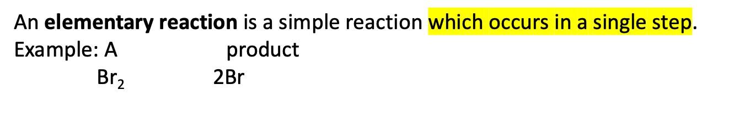
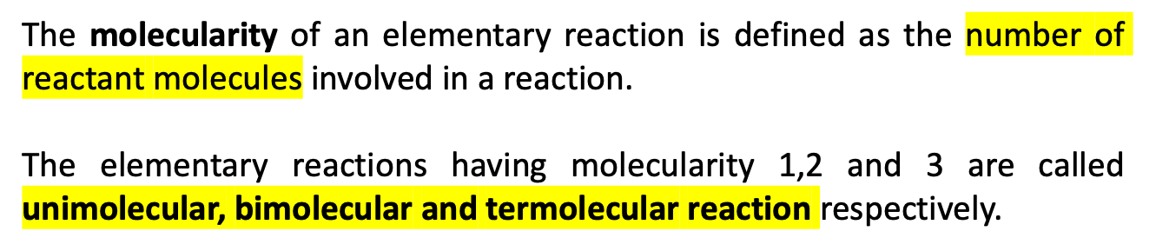
Chemical Reaction
Elementary reaction
Composite reaction
Molecularity of an elementary reaction

Slide 3
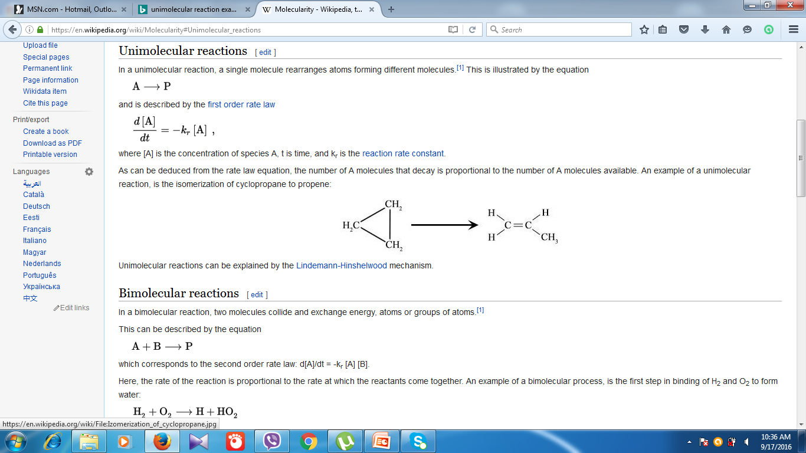
(a) Unimolecular reactions:
Molecularity = 1
A product
Br₂ 2Br
Example:
Cyclopropane propene
(b) Bimolecular reactions:
Molecularity = 2
A + B products
A + A products
Example: (i) 2HI H₂ + I₂
(ii) CH₃COOC₂H₅ + H₂O CH₃COOH + C₂H₅OH
Ethyl acetate acetic acid ethanol

Slide 4
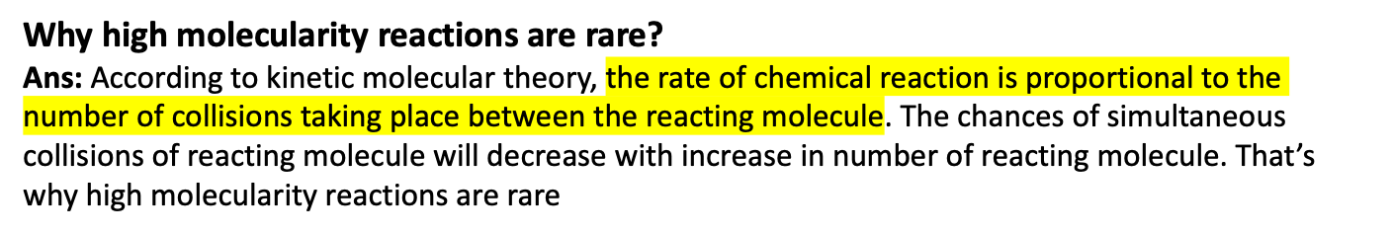
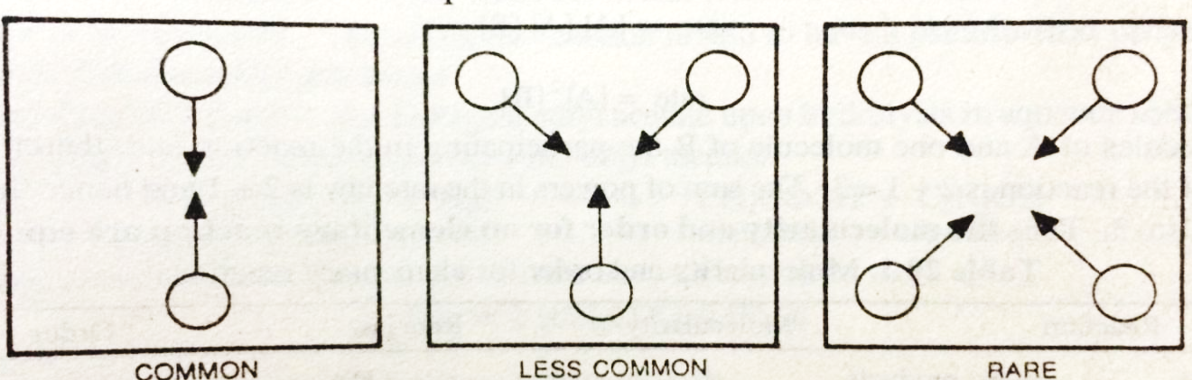
(c) Termolecular reactions:
Molecularity = 3
A + B + C products
Example: (i) 2NO + O₂ 2NO₂
(ii) 2NO +Cl₂ 2NOCl
Chances of simultaneous collision between reacting molecules decrease as the molecularity increase

Slide 5
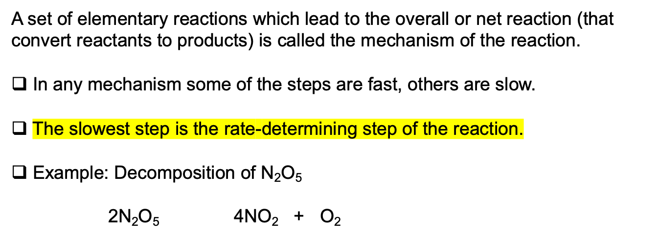
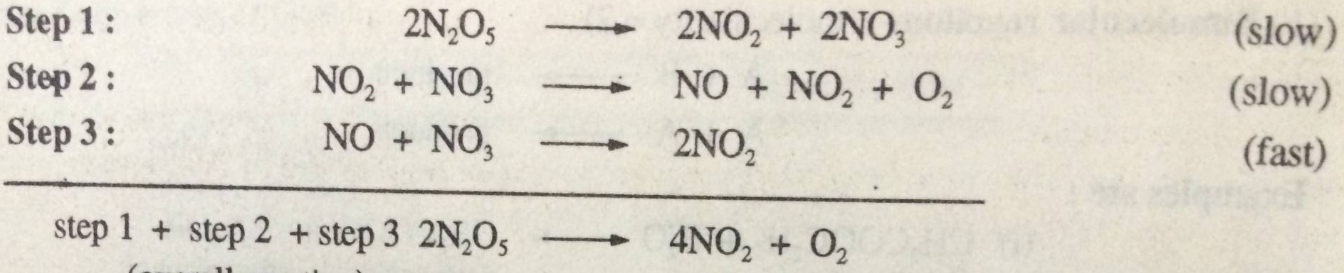
Reaction mechanism
This is a composite reaction. It occurs by the following steps:
Second step is the rate determining step.

Slide 6
Composite reaction
The reaction which have more than one elementary step is called complex reaction.
Example:
Side or parallel reaction
Reversible or opposing reaction
Consecutive reaction
Side or parallel reaction
The reaction in which more than one product formed from the reactant.
Example:
A B
C
D
Reversible or opposing reaction
A reaction is said to be reversible if forward reaction is opposed by backward reaction.
A B
Consecutive reaction
The reaction in which the final product is formed through one or more intermediate steps are called consecutive reaction.
A B C

Slide 7
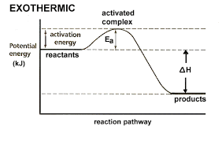
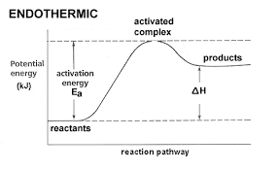
Reaction Intermediate: A reaction intermediate is a species produced during an elementary step of reaction but does not appear in the net reaction equation.
Example: In decomposition of N₂O₅ , NO₃ is said to be a reaction intermediate.
Potential energy diagram
A potential energy diagram plots the change in potential energy that occurs during a chemical reaction.
Reaction co-ordinate
Reaction co-ordinate
Fig: Potential energy diagram for exothermic and endothermic reaction

Slide 8
Terms of potential energy (PE) diagram
Endothermic Reactions: the reactants have less potential energy than do the products.
Exothermic Reactions: the reactants have more potential energy than the products have.
Activation energy, E_{a}: The minimum energy required to initiate a chemical reaction. So the energy required by reactant molecule to be converted into product is called activation energy, E_{a}.
It is the difference in energy between reactant and transition state.
Activated complex: Activated complex is a grouping of atoms of reactant molecule that is unstable and breaks up or decompose at a definite rate to give the products of the reaction.
All the reactants proceed through formation of an intermediate activated complex or transition state before forming product (transition state theory). Activated complex has higher potential energy than reactants or products.
AB + C AC + B
AB + C A…..B…..C AC + B
activated complex
In spite of collision between molecules reactions cant take place unless the energy barrier is crossed

